Slide 1
Incremental String Comparison
SIAM J. COMPUT., Vol. 27, No. 2, pp. 557-582, 1998
Reporter：Chiou-Ting Tseng
Date：Nov. 17, 2005

Slide 2
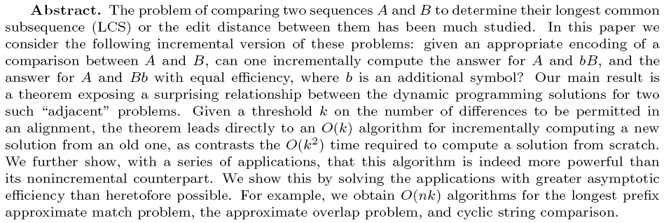
Abstract

Slide 3
Problem
Given a solution for the comparison of A and B, compute a solution for A versus bB, where b is an additional symbol prepended to B.
The matrix for A versus B, and the matrix for A versus bB can differ in O(mn) entries.

Slide 4
h-wave
For all points (i, j): D[i, j] − D[i−1, j−1] ∈{0,1}.
For all points (i, j): D[i, j]−D[i−1; j],D[i, j]−D[i, j− 1]∈{−1,0,1}.
Diagonal d
L^{h}(d)=max{i: D[i, i+d] = h}
h-wave L^{h} =<L^{h}(-h), L^{h}(-h+1),…, L^{h}(0),…, L^{h}(h-1), L^{h}(h)>.

Slide 5
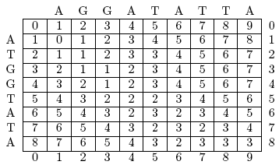
Example(1)

Slide 6
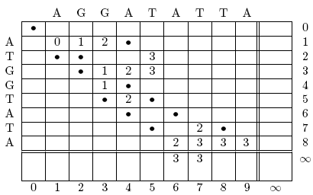
Example(2)

Slide 7
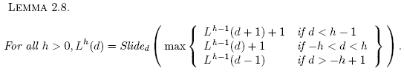
Slide(1)
Slide_{d}(i) = max{q : A[i…q] = B[i+d…q+d]}

Slide 8
Example

Slide 9
Slide(2)
In a preprocessing step one computes a suffix tree of the string AxBy = a₁a₂…a_{m}xb₁b₂…b_{n}y where x≠y are two symbols not in the alphabets of A and B.
One further preprocesses this suffix tree to allow any least common ancestor query over the tree to be answered in O(1) time. This preprocessing takes O(n) time.

Slide 10
Slide(3)
Slide_{d}(i) = depth(LCA(leaf(i),leaf(m + 1 + i+d)))
O(n+k²)

Slide 11







Result
We show that is composed of a concatenation of a prefix of , a sublist of , a suffix of , and at most two points p₁ and p₂, separating the sublists of L_{old}, not included in any of the old waves , , .

Slide 12
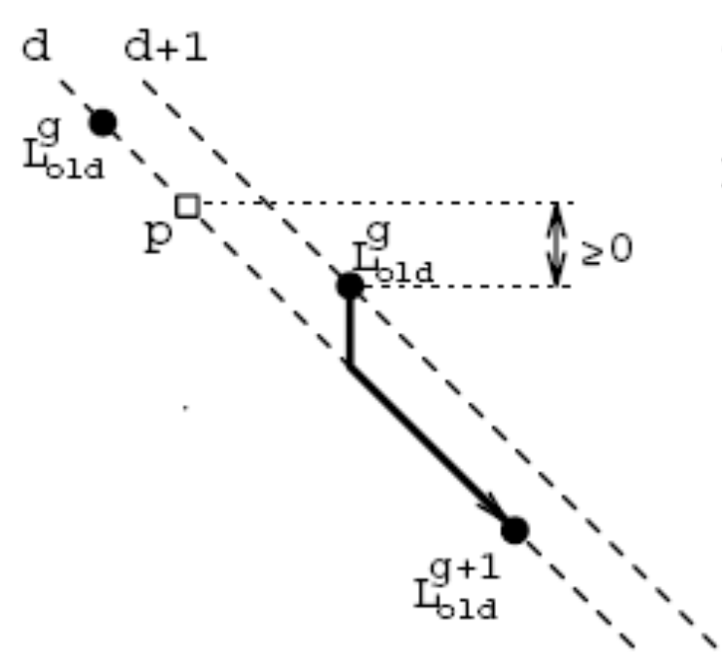
Key value
key(p) describes p’s position relative to points in the old waves.

Slide 13
Example
 |  | A | G | G | A | T
 | 0 | 1 | 2 | 3 | 4 | 5
A | 1 | 0 | 1 | 2 | 3 | 4
T | 2 | 1 | 1 | 2 | 3 | 3
G | 3 | 2 | 1 | 1 | 2 | 3
G | 4 | 3 | 2 | 1 | 2 | 3
T | 5 | 4 | 3 | 2 | 2 | 2
 |  | T | A | G | G | A | T
 | 0 | 1 | 2 | 3 | 4 | 5 | 6
A | 1 | 1 | 1 | 2 | 3 | 4 | 5
T | 2 | 1 | 2 | 2 | 3 | 4 | 4
G | 3 | 2 | 2 | 2 | 2 | 3 | 4
G | 4 | 3 | 3 | 2 | 2 | 3 | 4
T | 5 | 4 | 4 | 3 | 3 | 3 | 3

Slide 14
Observation 4

Slide 15
First Key Property
The first key property says that key values are strictly decreasing along in-between points and are otherwise nonincreasing.

Slide 16
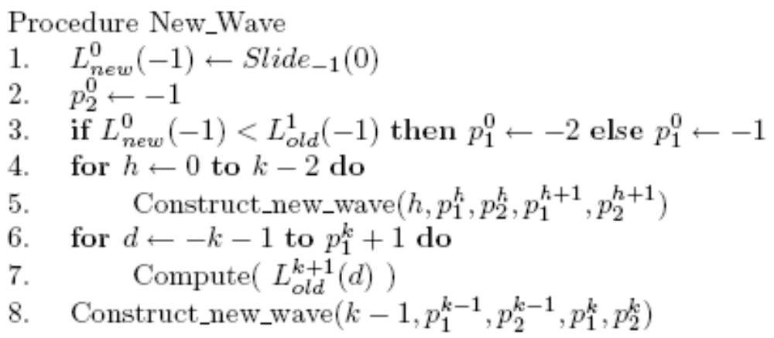
Algorithm(1)

Slide 17
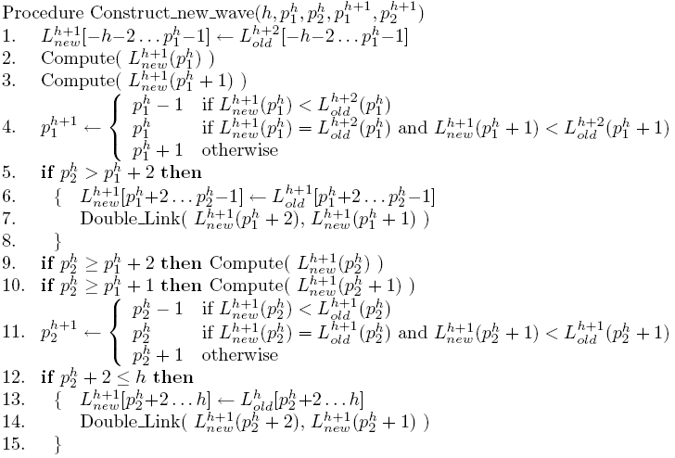
Algorithm(2)

Slide 18
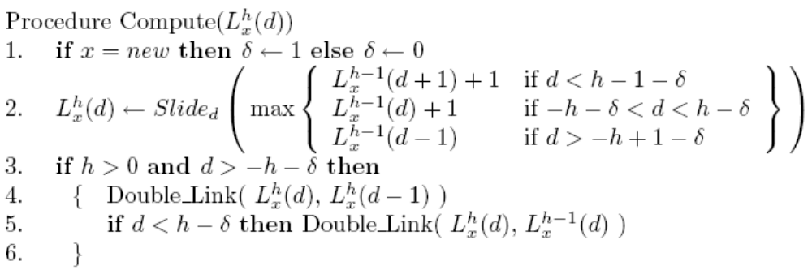
Algorithm(3)

Slide 19

LCS
Mismatch is not allowed,so D[i, j]- D[i-1, j-1]∈{0, 2}
L_{h}= <L_{h}(−h), L_{h}(−h+2),...,L_{h}(h−2), L_{h}(h)>.
Wave h in D_{new}( ) is the concatenation of (up to) three pieces: (i) a prex of , (ii) an in-between point p with key(p) = h+ 0.5, and (iii) a suffix of .

Slide 20
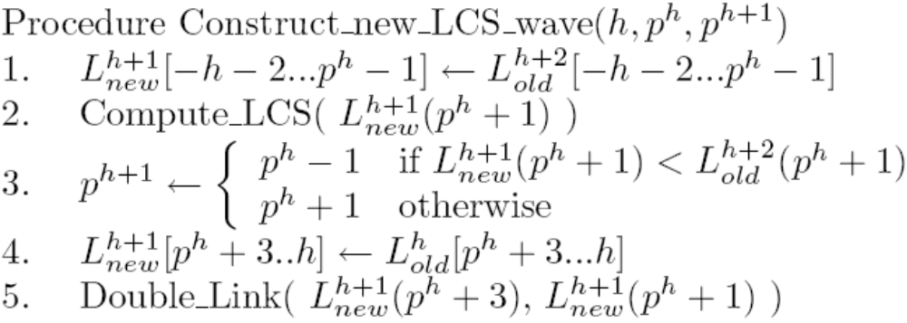
LCS Algorithm

Slide 21
Approximate String Matching
The longest prefix approximate match problem is, given strings A, B, and threshold k, to find for each l the length m(l) and the set of indices r such that ED(A^{m(l)},B[l...r] )≦k, m(l) = max{p∈[0,m] : ∀r∈[l, n], ED(A^{p},B[l,...,r]≦k}.

Slide 22
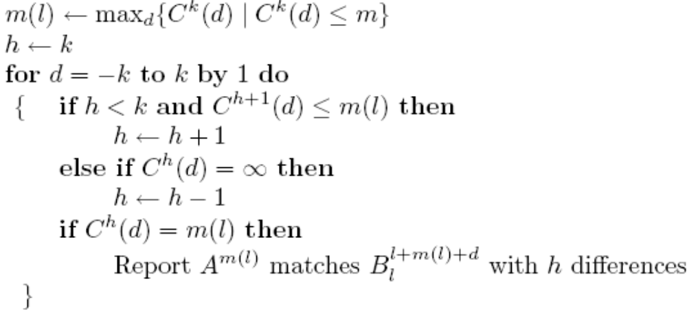
Algorithm

Slide 23
Example
A = aaaacbbbbccccc and B = xxxxxaaaaccccccbbbbcccccxxxx
B[5-15], B[14-24], B[5-24]

Slide 24
Approximate Overlap
Given a threshold k and strings A and B of length m and n, the approximate overlap problem is finding three indices l, r, and p such that
(a) r = n or p = m, and
(b) ED(A^{p},B[l,...,r] ) = h≦k, and
(c) Pr_{Σ}[p, r − l, h] is minimal.
When r = n the approximate overlap is of the dovetail variety, and when p = m it is of the containment type.

Slide 25
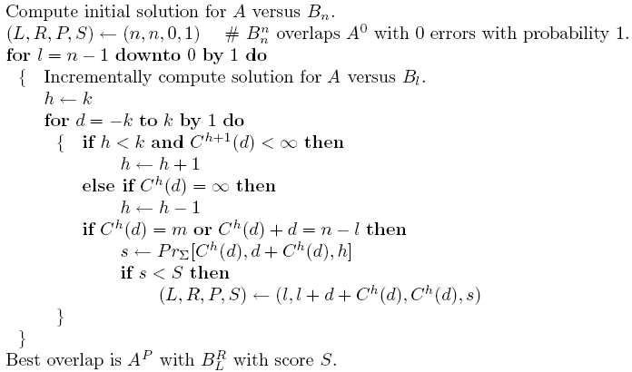
Algorithm

Slide 26
Cyclic String Comparison
The cyclic string comparison problem is to determine p and q such that e = ED(cycle^{p}(A); cycle^{q}(B)) is minimal.
Apply the algorithm on A and B’=BB (Add from B to B’), O(nk)
Let threshold be 1, 2, 4,...,e can decrease the order to O(ne)

